Slide 1
Incident Response Policy

Slide 2
Policy elements
Policy governing incident response is highly individualized to the organization.
However, Most policies include the same key elements.

Slide 3
Key elements of every policy
Statement of management commitment
Purpose and objectives of the policy
Scope of the policy
Definition of Computer Security incidents and related terms

Slide 4
Key elements of every policy
Organizational Structure and definition of roles, responsibilities and levels of authority
Includes the authority of the incident response team to confiscate or disconnect equipment and to monitor suspicious activity
Requirements for reporting certain types of incidents
Requirements and guidelines for external communications and information sharing
Escalation points in the incident management process

Slide 5
Key elements of every policy
Prioritization or severity ratings of incidents
Performance measures
Reporting and contact forms

Slide 6
Planning related elements

Slide 7
Plan elements
Organizations should have a formal, focused and coordinated approach to responding to incidents
Each organization needs a plan that meets its unique requirements
Unique requirements relates to
Organization’s mission
Organization’s size
Organization’s structure
Organization’s functions

Slide 8
Plan elements
Plan should include the following elements:
Mission
Strategies and goals
Senior Management approval
Organizational approach to incident response
How the incident response team will communicate with the rest of the organization and with other organization
Roadmap for incident response capability
How the program fits into the overall organization2

Slide 9
Sharing information with outside parties

Slide 10
Sharing of the information
Organization often need to communicate with outside parties regarding incident
It may include
Contacting law enforcement
Fielding media inquiries
Seeking external expertise

Slide 11
Sharing of the information
Another example can be – discussing incidents with other involved parties
ISP
The vendor of vulnerable software
Other Incident response teams
Organizations may also proactively share relevant information with peers to improve detection and analysis of incidents
Team should discuss information sharing with organization’s public affair office, legal department and management to establish policies and procedures.

Slide 12
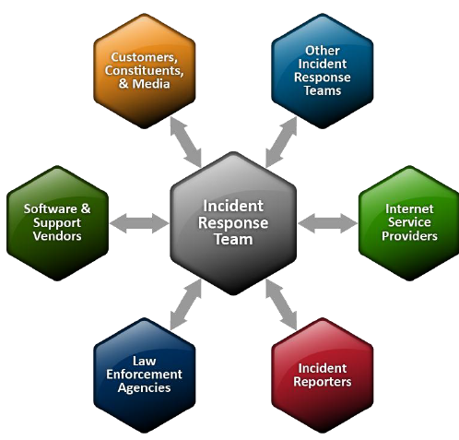
Communication with outside parties

